Slide 1



DevOps Sprint 8 End of Sprint Demo
Continuous Deployment Through VSTS
By
Justin Baacke
Continuous Deployment Pipelines

Slide 2
Agenda
Biography and Introduction
Terminology and Disclaimer
Setting up continuous integration builds in VSTS
A very nice checkbox
Build Variables
Task Groups
Continuous Deployment Pipeline for Kiosk software
The Challenge
The Build
The Path
The Trigger
The Deploy
Continuous Deployment Pipeline for AWS Architecture
CloudFormation Templates
The Auto-Deployment Stack
Deploying a template
Deploying a Lambda
Templates with External References

Slide 3
Biography and Introduction
Me: Justin Baacke
With Kiosk for 2 years
Started with Managed Services
DevOps for 8 months
Not actually an expert in anything but kinda ok at math
Company: Kiosk
We make kiosks
Production environment managed by Managed Services Team through an RMM tool called Kaseya
Cloud infrastructure in AWS
Generally awesome place to work
Topic: VSTS integration with DevOps and continuous deployment pipelines
Manage Code and projects in VSTS
Need to deploy QA code to kiosks in the same way it is deployed to production
Need a reliable way to deploy cloud infrastructure

Slide 4
Terminology and Disclaimer
AWS Terminology:
VSTS: Visual Studio Team Services: Web based platform for collaboration and source control produced by Microsoft.
AWS: Amazon Web Services: Amazon’s cloud computing platform
S3: Simple Secure Storage: File storage solution for AWS
Lambda: Serverless code managed by AWS
Yell at me if I start using acronyms
I am not a developer or a speaker:
I appreciate any input on my code, but there is likely to be enough “room for improvement” to take too much time to do live
Please hold questions for the question sections

Slide 5
Setting Up Continuous Integration Builds in VSTS

Slide 6
Setting Up Continuous Integration Builds in VSTS
VSTS has a built in Continuous or Scheduled Integration process for builds.
Enabling this is a checkbox (technically a slider with the new view)
You select which branches should have active continuous integration builds

Slide 7
Setting Up Continuous Integration Builds in VSTS
Build Variables
Set at build time
Give you control over different versions of your build
Can be “Locked” to hide sensitive parameters (Passwords, Access tokens, Customer information…)

Slide 8
Setting Up Continuous Integration Builds in VSTS
Task Groups
Defined set of build actions
Allow you to specify their inputs as variables
Allow for abstraction and duplication of common sets of tasks
Can be imported and exported as .json.

Slide 9
Questions?

Slide 10
Continuous Deployment Pipeline for Kiosk Software

Slide 11
Continuous Deployment Pipeline for Kiosk Software: The Challenge
Kiosks in the field are managed by the RMM utility called Kaseya
Almost all other communication to the units is blocked for customer security concerns
Managed Services team maintains and updates kiosk applications through this utility
We need to test this deployment as part of our builds so we know if it is ever broken

Slide 12
Continuous Deployment Pipeline for Kiosk Software: The Build
Kiosks in the field are managed by the RMM utility called Kaseya
Almost all other communication to the units is blocked for customer security concerns
Managed Services team maintains and updates kiosk applications through this utility
We need to test this deployment as part of our builds so we know if it is ever broken

Slide 13
Continuous Deployment Pipeline for Kiosk Software: The Path
Build the package
Upload the package to an S3 Bucket
Download the package to the Kaseya Server
Trigger Kaseya to download and deploy the package to the unit

Slide 14
Continuous Deployment Pipeline for Kiosk Software: The Trigger
S3Syncer program to monitor the S3 bucket
Download new package
Throw alert Kaseya can see
Use Kaseya’s monitoring ability to look for an alert
As an RMM utility Kaseya can monitor windows event logs
Set triggers to deploy when an event is seen from the S3Syncer program

Slide 15
Continuous Deployment Pipeline for Kiosk Software: The Deploy
Kaseya pushes out the package through a standard set of scripts used by the MS team and reboots the unit
Whole process takes about 5 minutes.

Slide 16
Questions?

Slide 17
Continuous Deployment Pipeline for AWS Architecture

Slide 18
Continuous Deployment Pipeline for AWS Architecture: CloudFormation Templates
Allow you to define your AWS resources in a templateable and repeatable document
Provide a centralized management platform for your “Stacks”
Can take inputs and provide outputs
Allow you to store your architecture diagram as your code.

Slide 19
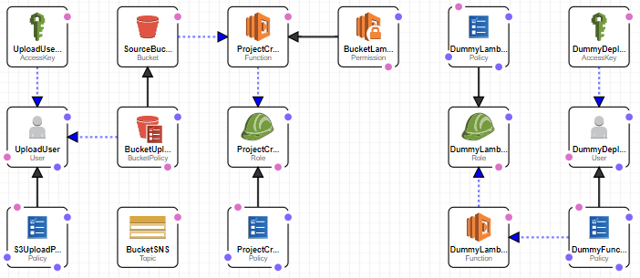
Continuous Deployment Pipeline for AWS Architecture: The Auto-Deployment Stack

Slide 20
Continuous Deployment Pipeline for AWS Architecture: Deploying a Template
Manually
Through VSTS and the Auto-Deployment Stack

Slide 21
Continuous Deployment Pipeline for AWS Architecture: Template with a Lambda
Simply declare the lambda as a resource in the stack
Build the lambda using a set of build steps
Upload the lambda first
Kiosk Standard is to use a /Resources/ folder at the same level as the master.template.

Slide 22
Continuous Deployment Pipeline for AWS Architecture: Template External References
Same Idea as the lambda, simply declare the resource
Condensing infrastructure
Referencing outside services

Slide 23
Questions?

Slide 24
References
I will put the code for this in a GitHub repo: https://github.com/jbaacke/Kiosk-CD-Pipelines
AWS Documentation for CloudFormation: https://aws.amazon.com/documentation/cloudformation/
JBaacke@kiosk.com

